Slide 1


WELCOME
WELCOME PURIUM MEMBERS
REAL FOOD REVOLUTION
TRANSFORMATION • LIFESTYLE • GIFT CARDS

Slide 2


Learn about our PRODUCTS
Raise
your hand
if you eat.

Slide 3

Learn about our BUSINESS
Raise
your hand
if you know
anyone else
who eats.

Slide 4

WHO are we?
Manufacturer of whole food,
raw food, superfoods in
Long Beach, CA for 23 years.
Market is moving towards us:
No artificial ingredients
No genetically modified ingredients
20 point purity/potency commitment
Partner directly with manufacturer
Better products at a lower price

Slide 5

GROWING Fast!
We are 32 times bigger
than we were just
32 months ago!
Our sales in 1 DAY now equals
our sales in 1 MONTH in 2012.

Slide 6

GROWING Fast!
2013: #4584
2014: #1487
(Up 3,097 places)
2015 will be our
3rd year in a row!

Slide 7

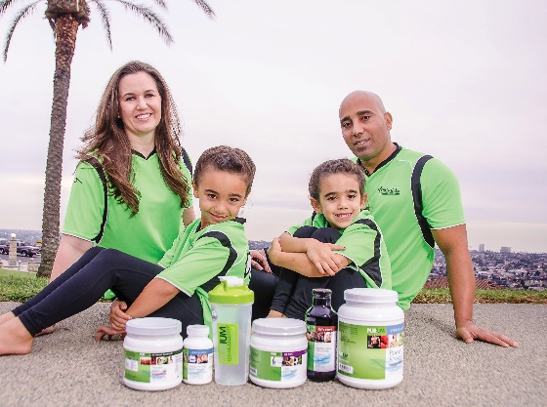

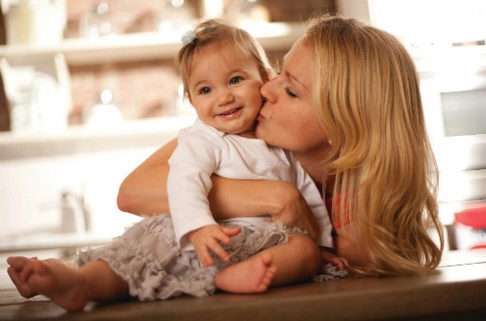


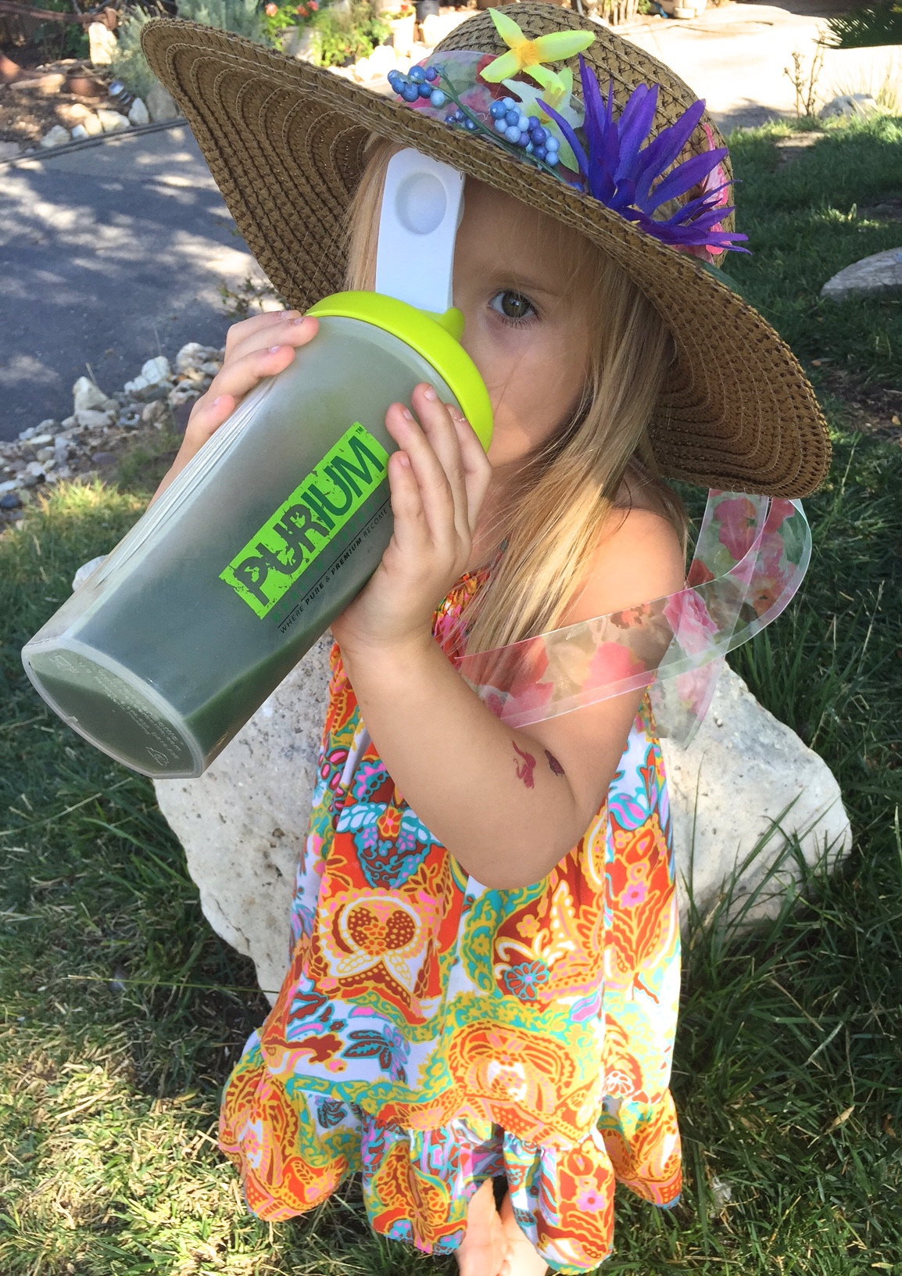
We are on a MISSION
Help 1 million families
1,000 women
100 communities
10 families each
www.millionmommovement.info

Slide 8

Farm to Family VIDEO

Slide 9
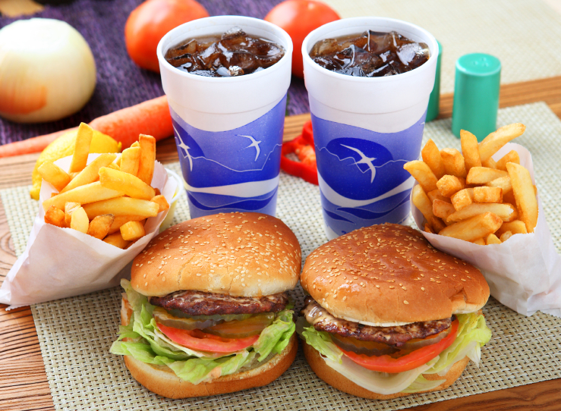
PROBLEMS with our food
Most food that we eat:
Too much salt
Too much sugar
Too much fat

Slide 10

PROBLEMS with our food
Most food and drinks:
Artificial colors & flavors
Artificial sweeteners
Binders & fillers
Pesticides & hormones
Irradiated
Genetically modified

Slide 11
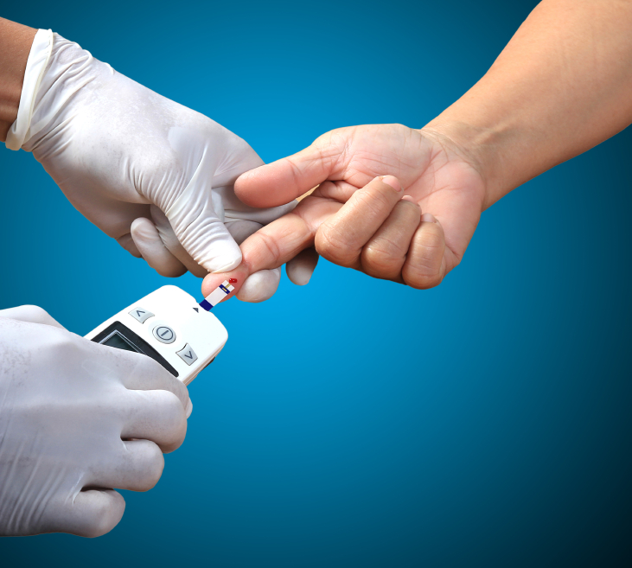
PROBLEMS with our food
Nutritionally Bankrupt Food
& Modern Lifestyle:
Alzheimers
Autism / ADDHD
Diabetes
Heart Disease / Cancer
Obesity
Superfoods = Super Life
Purium products are foods and supplements and do not cure or
treat any diseases.

Slide 12




Purium LIFESTYLE
It’s all about the lifestyle.
And it starts with just 10 days.
What are your goals?
We can help you get there.

Slide 13

10-Day TRANSFORMATION
10 day vacation from
processed foods.
This is the gateway
to a healthier lifestyle.

Slide 14

10-Day TRANSFORMATION
Detox.
Cleanse.
Metabolic re-set.
Break your addictions.

Slide 15

10-Day TRANSFORMATION
One healthy side effect.
Fastest, healthiest, simplest,
least expensive way
to lose weight on the planet.
Period.
Average loss:
11 pounds & 8 inches

Slide 16
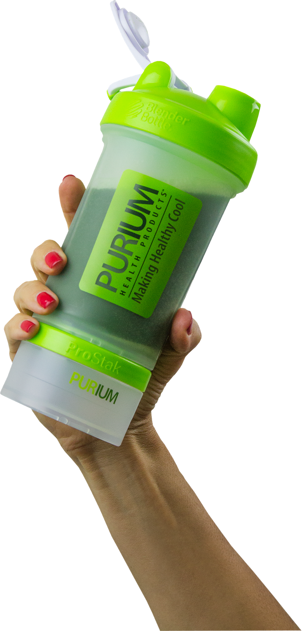

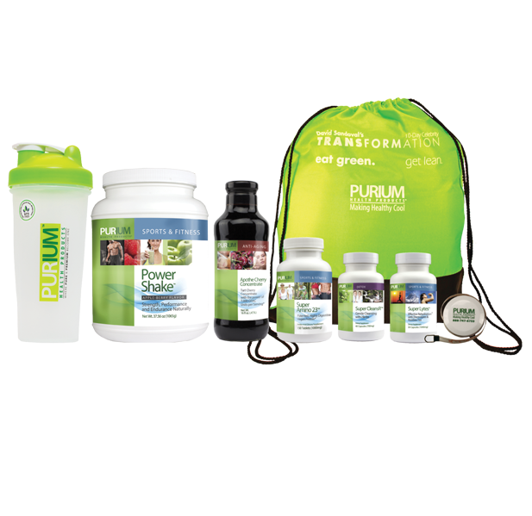
10-Day TRANSFORMATION
Just 23 dollars per day.
Eating choice
not a budget choice.
60-day guarantee.

Slide 17

Real people. Real RESULTS.
Results will vary for all participants.

Slide 18
Real people. Real RESULTS.
Please stand if you’ve lost at least
10 pounds since joining Purium!
20 pounds!!
30 pounds or more!!!
Let’s hear from some people in the room about their Transformation experiences.
Results will vary for all participants.
These claims have not been reviewed by the FDA.
Please consult a physician before starting any new health regimen.

Slide 19

CONTINUATION
Continue on YOUR Path
Weight Loss
Sports Performance
Anti-Aging
Family Nutrition
Superfood Superstore
50+ PURE/PREMIUM Products

Slide 20
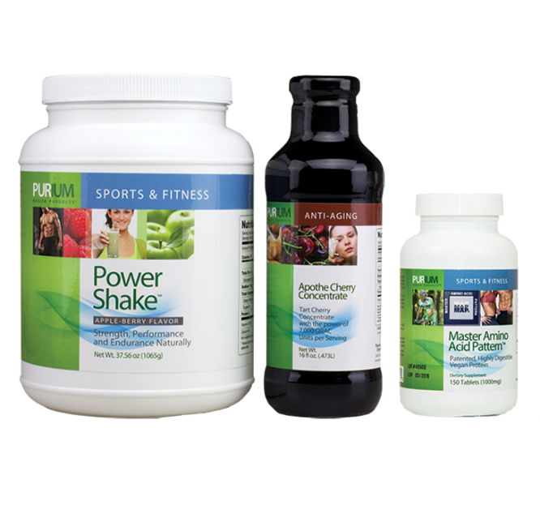
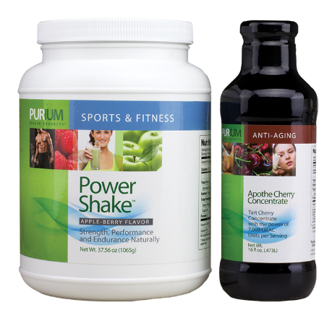
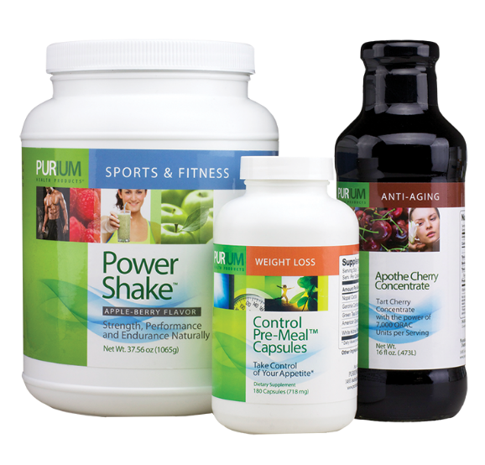

Recommended PACKS
4 simple options to continue:
About
$3-$5 per day
for a complete, targeted, superfoods nutrition program.

Slide 21


Purium LIFESTYLE Club
Save up to 30%!
Save $10 on S&H!
Free Naturopathic Doctor!
Monthly Product Specials!
Includes 5 Gift Cards!
(more on that in a minute)

Slide 22


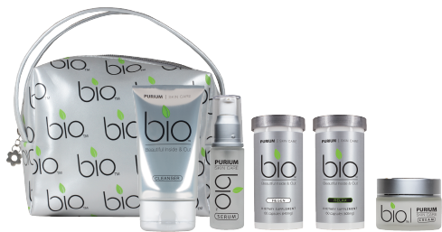
New! SKIN CARE
Noticeable results. Natural ingredients.

Slide 23



KIDS Products
4 New Kids Products
Launching This Fall!
Power Kids
Power Tabs
In Focus
Immune Shield

Slide 24

GIFT Card System
People don’t like to sell.
But they do like to SHARE.

Slide 25

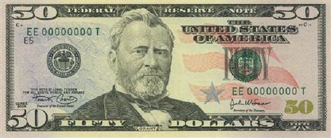
GIFT Card System
Purium pays you
to share.
Give $50. Get $50.
Enrollment Packs
pay out up to $350!

Slide 26



GIFT Card System
Simple. Simple. Simple.
Sample. Sample. Sample.
Choose a Gift Card code.
Text. Email. Post on Facebook.
Host a Healthy Happy Hour.
ANYONE can do this business!

Slide 27


GIFT Card System
Some people use the Gift Card
for a Transformation …
and receive 5 Gift Cards.
Some use it for an
Enrollment Pack …
and receive 20-100 Gift Cards!
DUPLICATION! DUPLICATION!

Slide 28
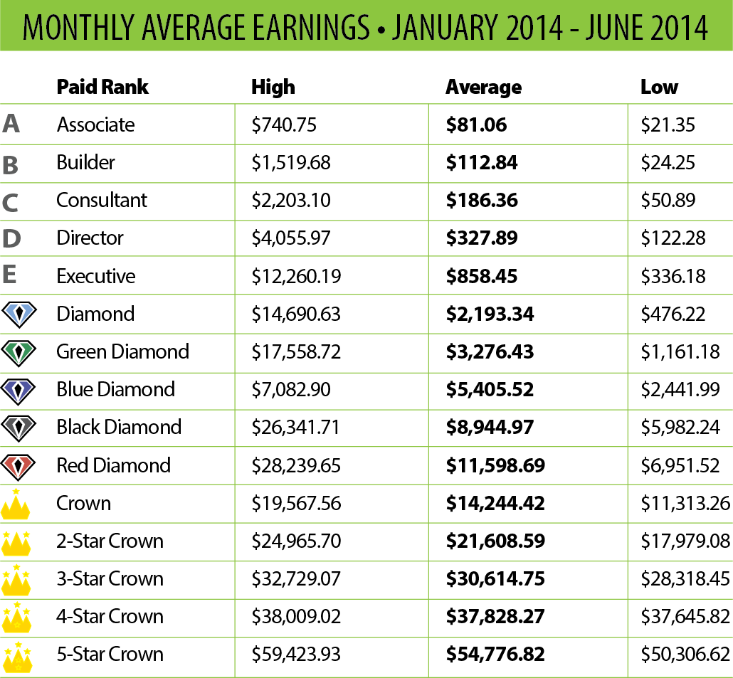
INCOME Opportunity
Income Disclosure Statement
The income statistics above are for all active Purium Members who were eligible to earn downline commissions between January and June, 2014. Note that these figures do not represent a Member's profit, as they do not consider expenses incurred by a Member in operation or promotion of his/her business. The figures above refer to gross income (total income before any expenses are deducted). The expenses a Member incurs in the operation of his/her Purium business vary widely. The earnings of the Members in this chart are not necessarily representative of the income, if any, that a Purium Member can or will earn through his or her participation in the Purium Compensation Plan. These figures should not be considered as guarantees or projections of your actual earnings or profits. Any representation or guarantee of earnings would be misleading. Success with Purium results only from successful sales efforts, which require hard work, diligence, and leadership. Your success will depend upon how effectively you exercise these qualities.

Slide 29
Real people. Real RESULTS.
Please stand if you have earned over
$500 in a single month with Purium!
Over $1,000!!
Over $3,000!!!
Let’s hear from some people in the room about their Purium business experiences.
Results will vary for all participants.
See our Income Disclaimer Statement for more details.

Slide 30
Quick RECAP
Everyone eats.
People are looking for healthier food.
We manufacture pure and premium products.
10-Day Vacation from Processed Foods
50+ Products: Wt Loss / Sports / Aging / Nutrition
Gift cards make it easy to share.
Inc. 5000 company almost no one has ever heard of.
We want you to join our movement!

Slide 31
Let’s get it STARTED!
Enrollment Tear Pad
How many Transformations do you want?
1 or 2 or more
Do you want to try BIO Skin Care or other products?
How many Gift Cards do you want?
5, 20, 50, 100
Which PLC Pack do you want?
Nutrition / Weight Control / Sports / Daily Max

Slide 32
Let’s get it STARTED!
Fast Start Training begins in 15 minutes

Slide 33

G.A.M.E. Plan

Slide 34
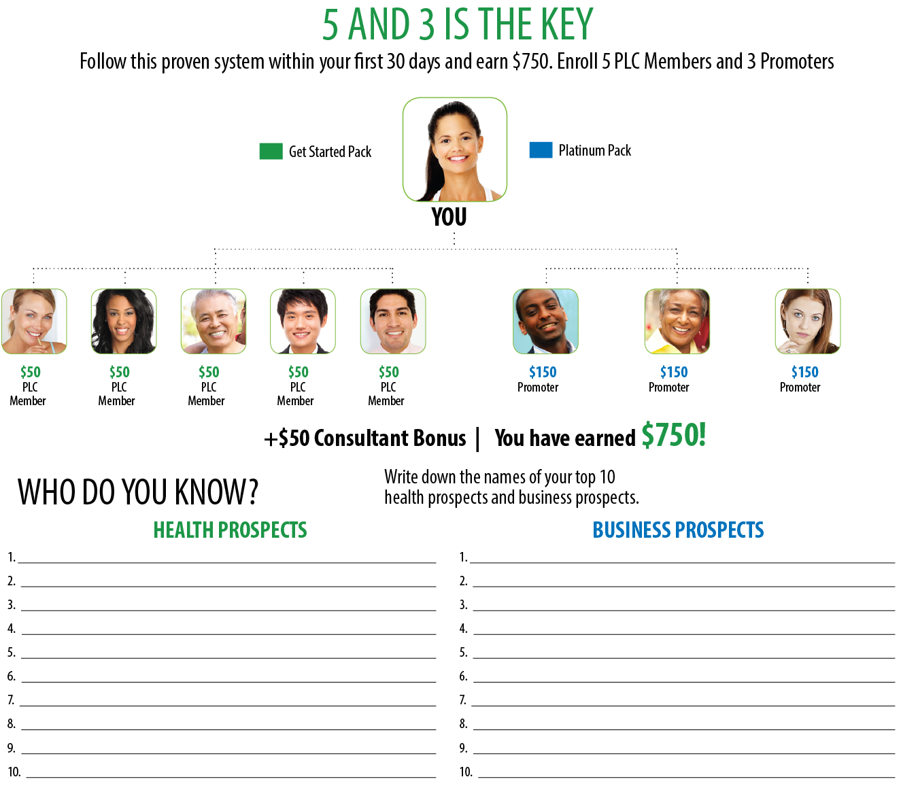
G.A.M.E. Plan
10 Health Prospects >>
5 PLC Members
10 Business Prospects >>
3 Promoters

Slide 35
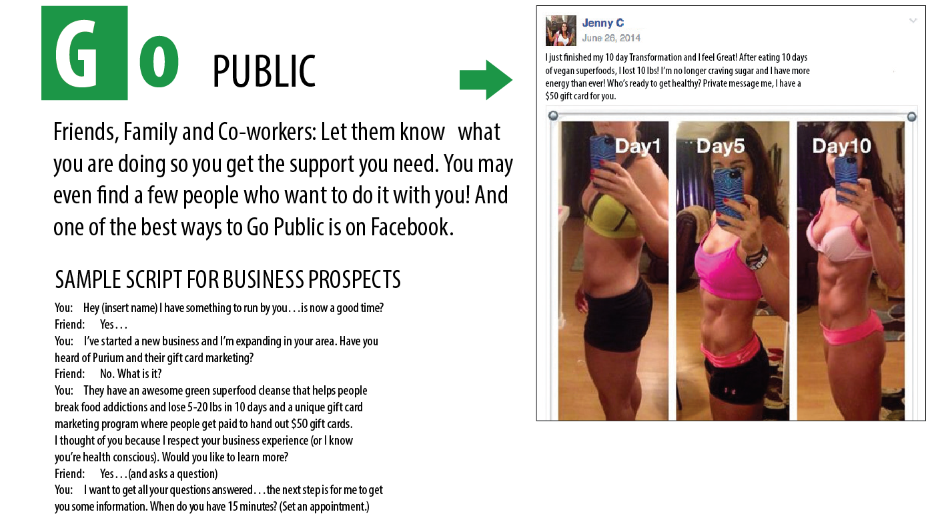
G.A.M.E. Plan
Text * Call * Email * Facebook * Purium Bottle

Slide 36
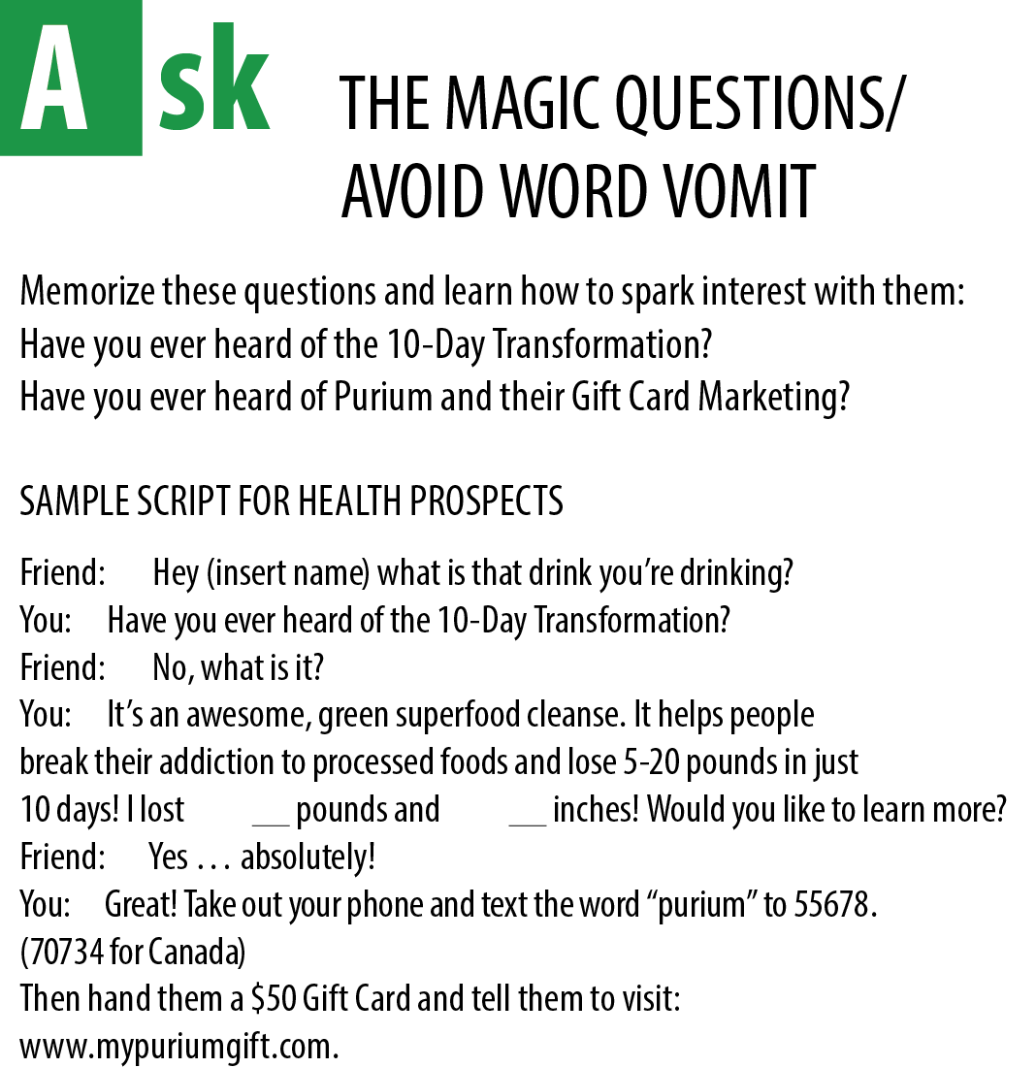
G.A.M.E. Plan
Health Prospects:
Have you ever heard of the 10-Day Transformation?
Business Prospects:
Have you ever heard of Purium and their Gift Card Marketing System?

Slide 37

G.A.M.E. Plan
Prosper * HHH Kit * Website * 3-Way * Text

Slide 38

G.A.M.E. Plan
Enroll * PLC Pack * GAME Plan * Plug In

Slide 39

Start FAST
Set your series of
Healthy Happy Hours
to launch your business.
Event Special:
FREE Shipping & Handling on a
Healthy Happy Hour Kit (only $49)

Slide 40

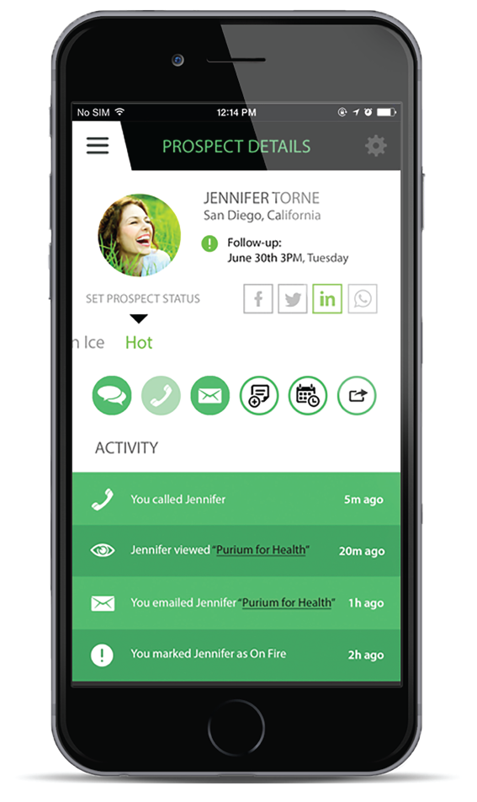
Start FAST
DREAMS
Technology
Platform
$14.95 per month
$149 per year (Save $30)

Slide 41

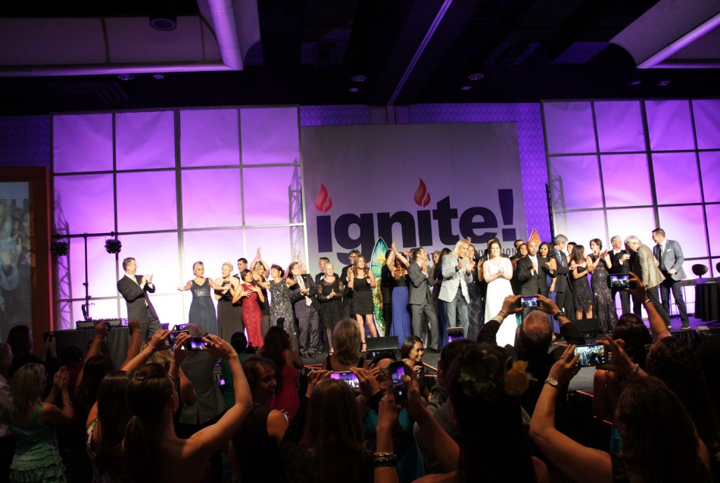

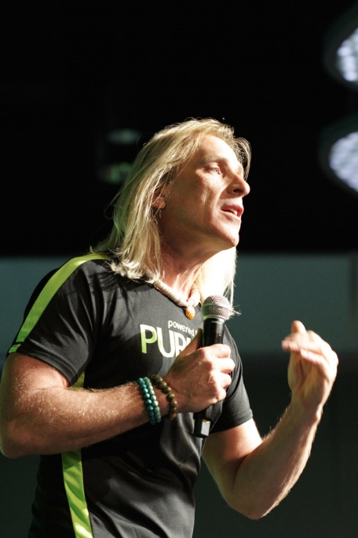
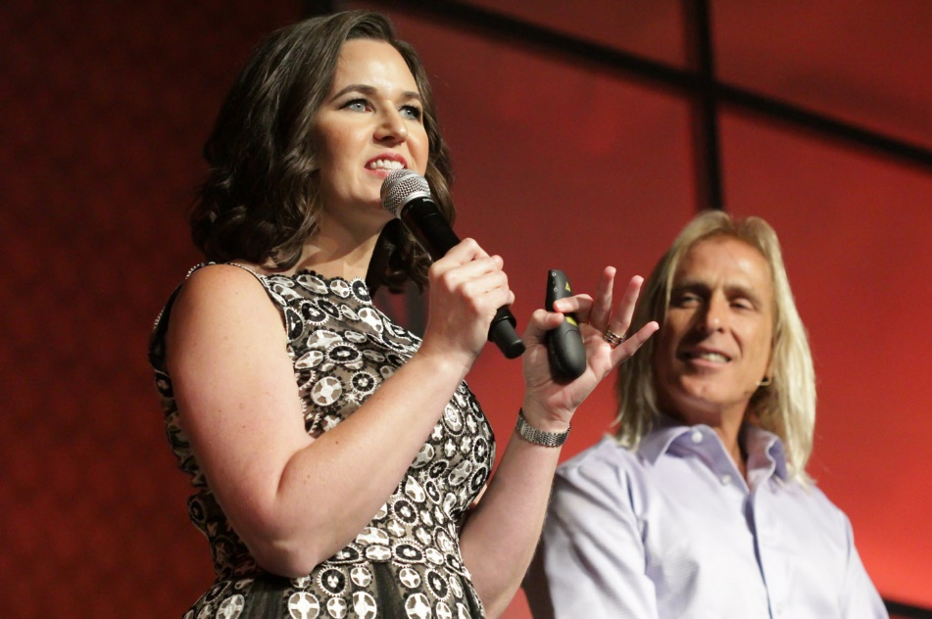
CONVENTION Re-Cap
Top 5 Launches
Bio Skin Care
Fall Road Trip
Farm to Family Video
US Hispanic Launch
Kids Products
(coming this fall)

