Slide 2
You’ll Love Our PRODUCTS
Do you eat?

Slide 3
Do you know anyone else who eats?
You’ll Love Our BUSINESS

Slide 4
VISION 2020
To Become the
“Whole Foods”
of Network Marketing
Green ~ Organic ~ Non-GMO ~ Super Foods

Slide 5
HIGHLIGHTS
23 Year Old Manufacturing Company Goes MLM
Best in Class, Proprietary Health Products
Sweet Spot Timing
Gift Card Marketing Magic
Highest Industry Cash Bonuses

Slide 6
GROWING Fast!
Purium has appeared
on the Inc. 5000 list of fastest growing US companies in 2013 & 2014.
Again in 2015 for sure!
2016 … Let’s do it!!

Slide 7
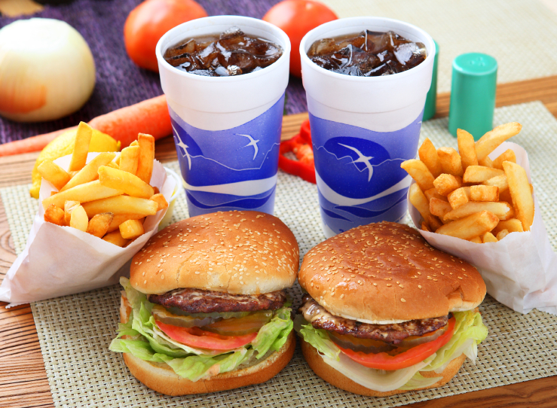
PROBLEMS with our food
Most Food and Drinks:
Artificial Colors & Flavors
Artificial Sweeteners
Binders & Fillers
Pesticides & Hormones
Irradiated
Genetically Modified

Slide 8
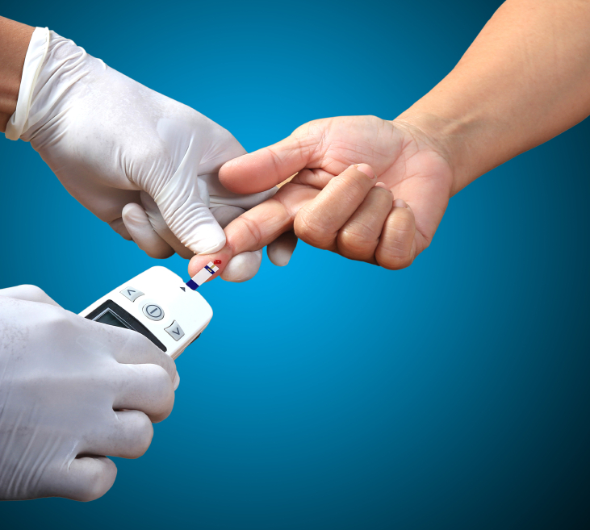
PROBLEMS with our food
Nutritionally Bankrupt Food
& Modern Lifestyle:
Alzheimers
Autism / ADDHD
Diabetes
Heart Disease
Cancer
Obesity
Purium products are foods and supplements and do not cure or treat any diseases.

Slide 9
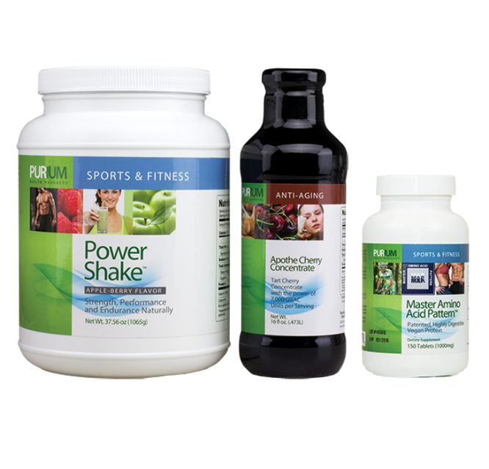
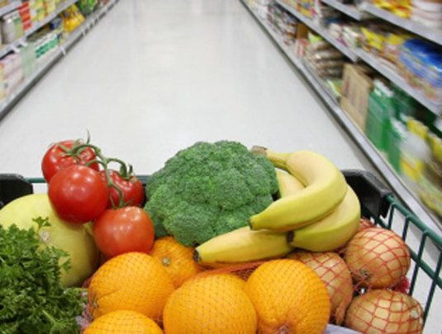
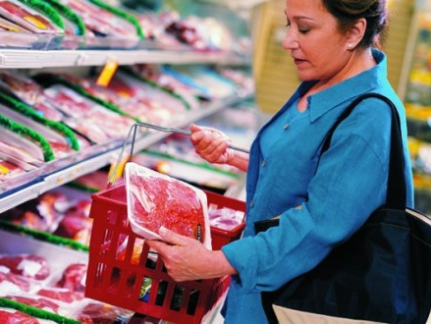
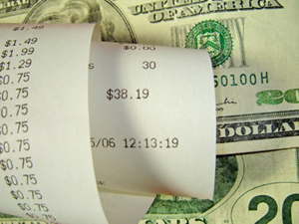
HEALTHY ALTERNATIVE
Protein, Fruits & Vegetables
Only $5 a day
Minimal effort.
Maximum results!

Slide 10
10-Day TRANSFORMATION
10-Day Vacation from Processed Food
Cleanse & Detoxify
Reset Metabolism
Increase Energy
Sleep Better
Age Gracefully
Lose Weight*
* Average weight loss: 11 pounds & 8 inches

Slide 11
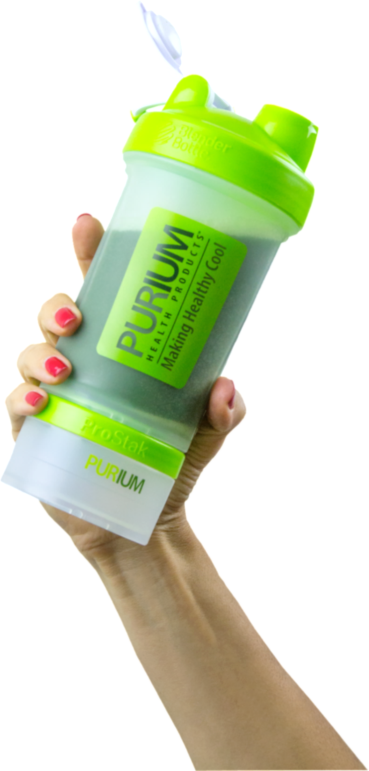
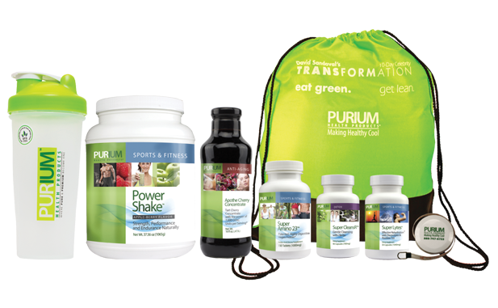
10-Day TRANSFORMATION
Just $23.00 per Day.
Eating Choice, Not a Budget Choice.
60-Day 100% Money Back Guarantee.

Slide 12
Note: Results will vary for each participant.
Real people. Real RESULTS.

Slide 13
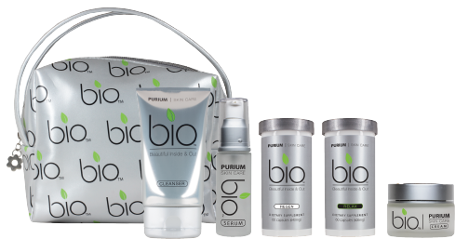
New! SKIN CARE
Noticeable results. Natural ingredients.

Slide 14
KIDS Products
4 New Kids Products
Power Kids
Multi Vitamin
In Focus
Immune Shield

Slide 15
The Purium LIFESTYLE
It’s not about Sacrifice,
it’s about Healthy Choices…

Slide 16
GIFT CARD Marketing
The “Unfair Advantage”
People don’t like to sell.
But they do like to SHARE!

Slide 17
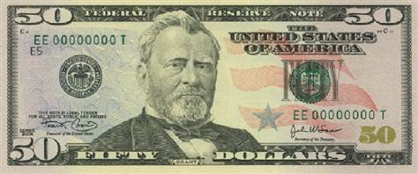
GIFT CARD Marketing
Get Paid to Share The Gift of Great Health.
Give $50 / Get $50
Get Paid to Give Away Gift Cards
You choose a Personal Gift Card Code.
Text. Email. Post on Social Media.

Slide 18
GIFT CARD Marketing
Duplication. Duplication. Duplication!
Earn significant commissions and bonuses when your team shares gift cards
Imagine your team giving away hundreds or even thousands of Gift Cards every month … and you get paid on all product sales FOREVER!

Slide 19
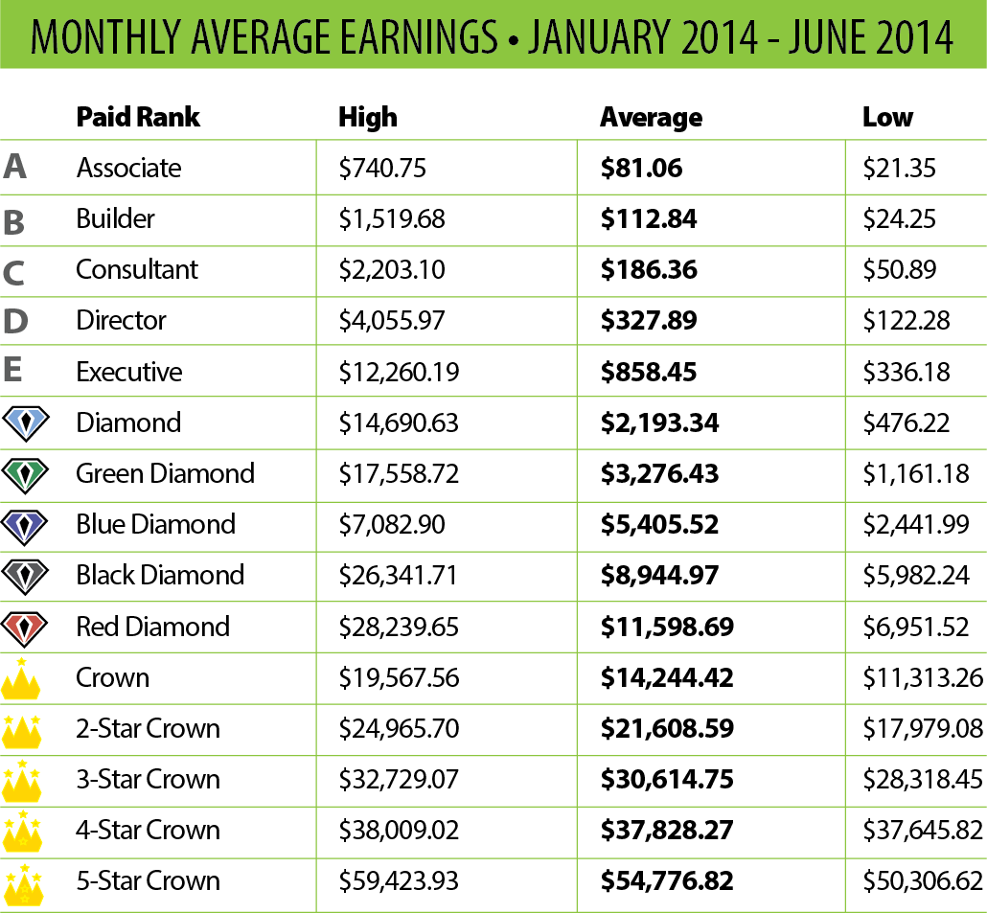
INCOME Opportunity
Choose your monthly income and we’ll help you get there!
Income Disclosure Statement
The income statistics above are for all active Purium Members who were eligible to earn downline commissions between January and June, 2014. Note that these figures do not represent a Member's profit, as they do not consider expenses incurred by a Member in operation or promotion of his/her business. The figures above refer to gross income (total income before any expenses are deducted). The expenses a Member incurs in the operation of his/her Purium business vary widely. The earnings of the Members in this chart are not necessarily representative of the income, if any, that a Purium Member can or will earn through his or her participation in the Purium Compensation Plan. These figures should not be considered as guarantees or projections of your actual earnings or profits. Any representation or guarantee of earnings would be misleading. Success with Purium results only from successful sales efforts, which require hard work, diligence, and leadership. Your success will depend upon how effectively you exercise these qualities.

Slide 20
Quick RECAP
Everyone eats every day … People Looking for healthy foods
We manufacture Best in Class Super Foods
Easy to get started … 60-Day Guarantee
Core3 or 10-Day Transformation
Gift Card Marketing
Fun to Share… Easy to Duplicate
Sweet Spot Timing
Inc. 5000 company … Almost Unknown

Slide 21
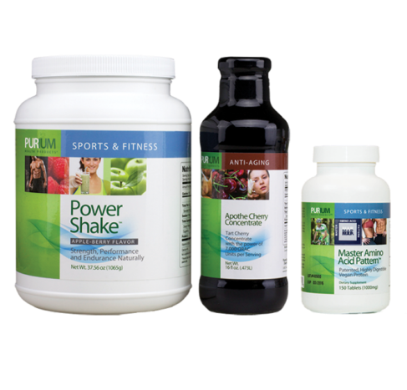
Let’s get it STARTED!
Get Started Pack
Wholesale Membership
Fruits, Veggies & Protein
10-Day Transformation
Wholesale Membership
Metabolic Re-set, Detox, Weight Loss
$249
$280
$199 With $50 Gift Card
$230 With $50 Gift Card

Slide 22
PROMOTER Packs
Platinum Pack Promote and Earn
Launch Pack Complete Biz in a Box
$3,000⁺ Value
$6,000⁺ Value
$549
$499 With $50 Gift Card
$1,049
$999 With $50 Gift Card

Slide 23
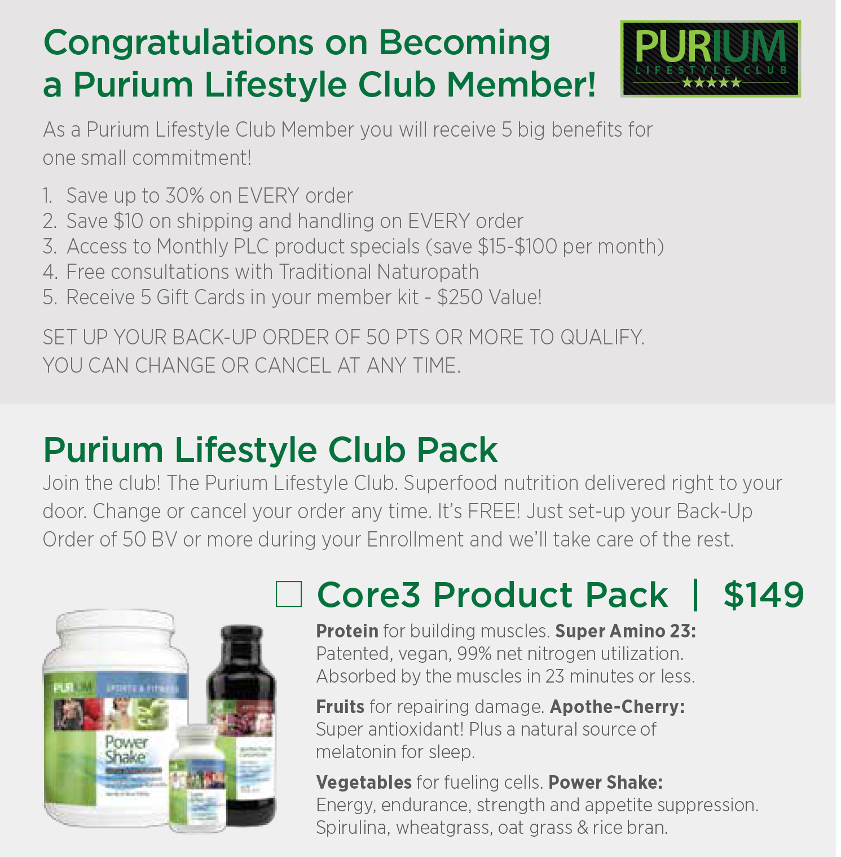
Purium Lifestyle Club
Monthly HEALTH PROGRAM
Only $5 a day!
All Your Protein, Fruits & Veggies
Save up to 30% on ALL orders
Save $10 on Shipping
Free Naturopathic Doctor Advice
Monthly Product Specials
$50.00 Additional Loyalty Reward
Includes 5 Gift Cards ($250 Value)
Commission Qualified
60 DAY PRODUCT GUARANTEE!

